Slide 1
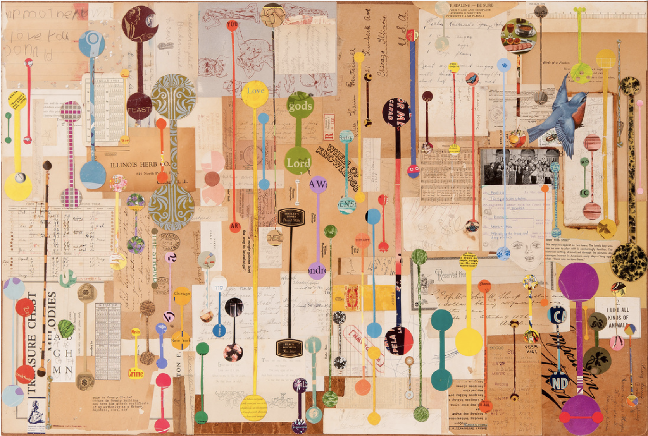
Lecture 6:
Functional enrichment

Slide 2

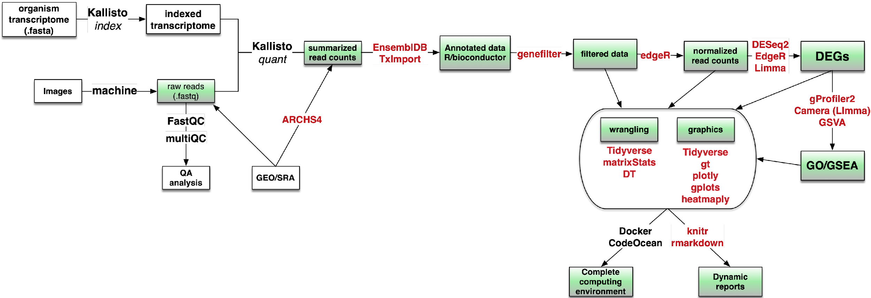
Tracking our progress in this course
1
2
5
Base R
4

Slide 3
Objectives for today
Carry out Gene Ontology (GO) enrichment analysis using modules identified in the previous script
Carry out a Gene Set Enrichment Analysis (GSEA) using our full dataset
Understand the differences between GO and GSEA
Understand the MSigDB resource and how to access signature collections

Slide 4
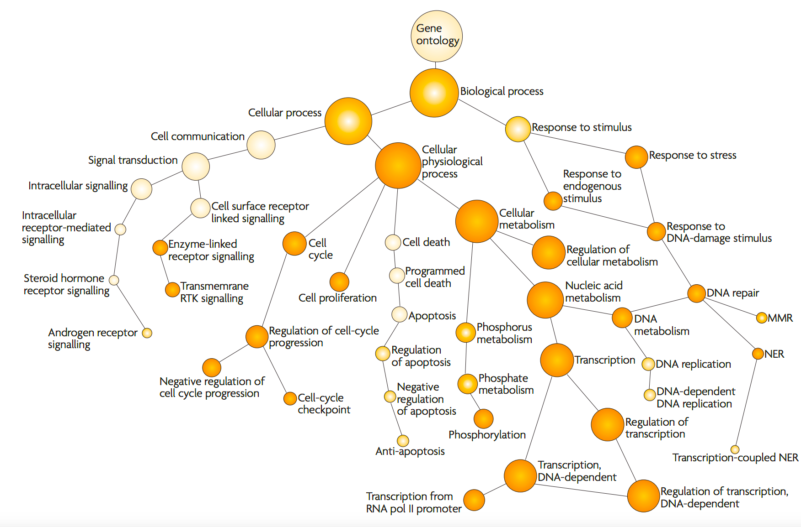
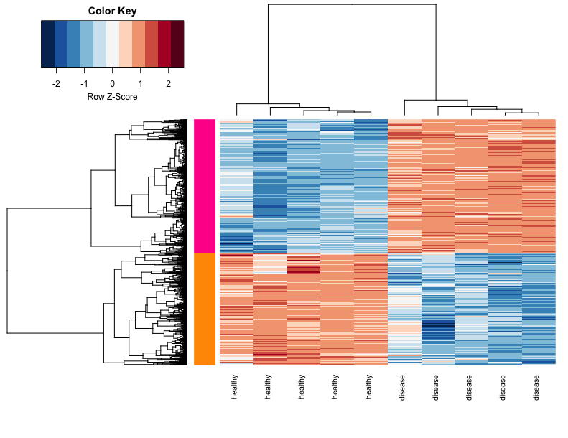
Functional Enrichment analysis
(a.k.a. pathway analysis)
At this stage, it is often worth considering why you set out to do an RNA-seq experiment in the first place!
What do all these genes do?

Slide 5
Functional Enrichment analysis
Two main approaches:
Gene Ontology (GO)
requires arbitrary selection of genes
does not require any data (gene identifiers only)
species specific
user doesn’t control vocabulary
2. Gene Set Enrichment Analysis (GSEA)
no need to pre-select genes
requires both identifiers and data
not species specific*
user can control vocabulary
Numerous web-based tools for GO and GSEA
Also commercial tools (e.g. Ingenuity IPA)
Notes:
*for GO, the species specificity comes when you choose your background
*for GSEA, all of msigDB is human, so when you compare you use msigDB to carry out your analysis, you are effectively removing any genes that don’t have human orthologs

Slide 6
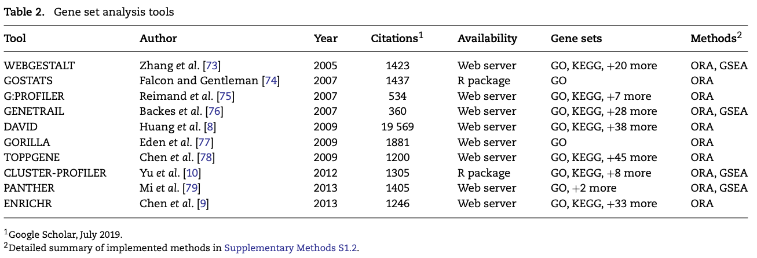
Many options for functional enrichment
popular website tools
used in the step 5 script
Hypergeometric or Fisher’s exact test
Geistlinger et al. Brief. in Bioinformatics, 2020

Slide 7
Gene Ontology
A structured vocabulary for describing gene function
>50,000 genes annotated with terms
~100,000 term-term relations

Slide 8
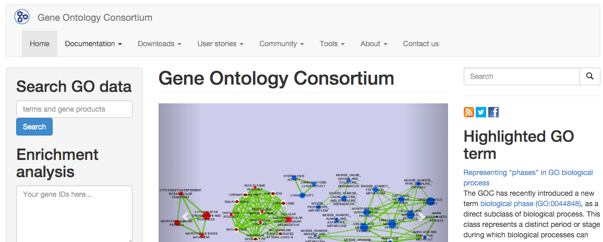
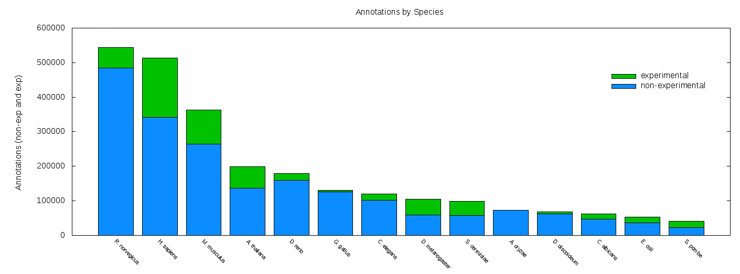
GO is manually curated

Slide 9
GO is really three different ontologies
Cellular
Component (CC)
Biological
Process (BP)
Molecular
Function (MF)
How does it carry out that function (via which molecular mechanisms)?
Where is the
gene product localized?
What function(s) does it perform in that location

Slide 10
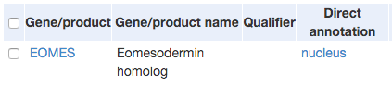
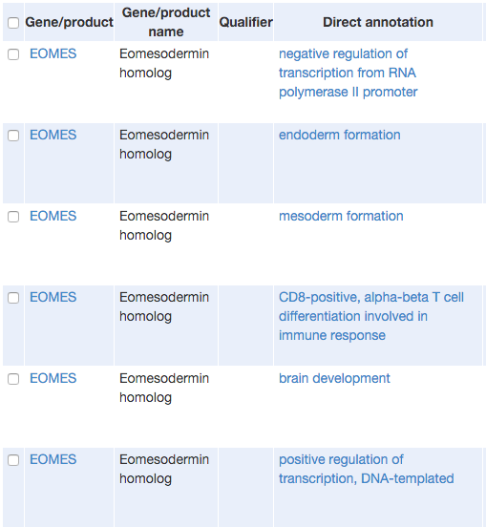

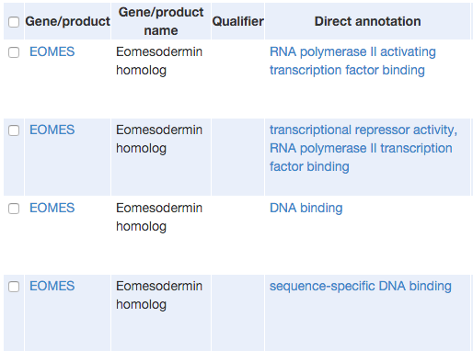

CC
BP
MF
GO is redundant, often requiring summarization of results

Slide 11
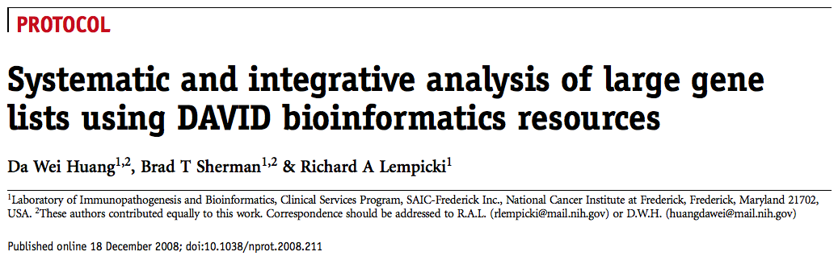
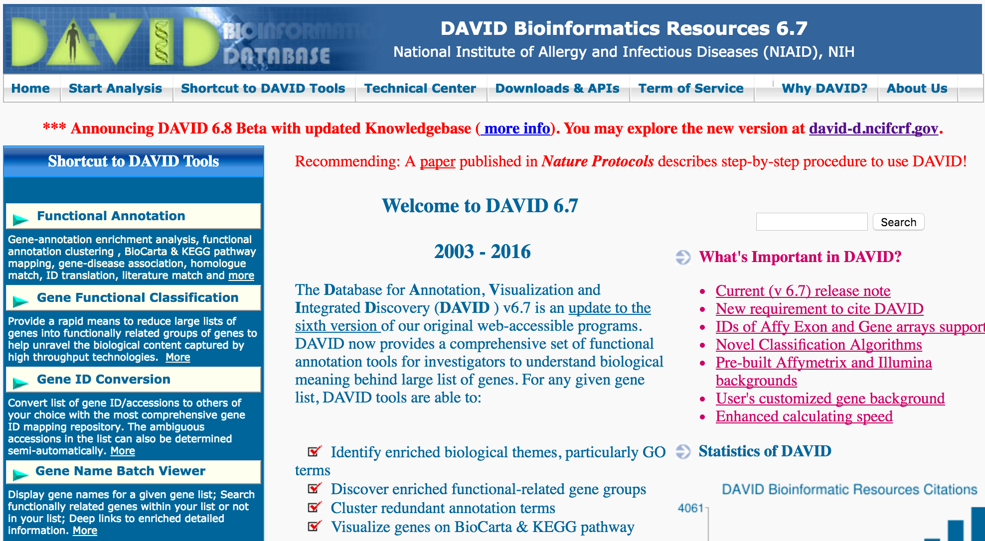

Slide 12

Broad Institute’s GSEA software
Lots of file formats to deal with.
But all are just simple text files you can prepare in Excel

Slide 13
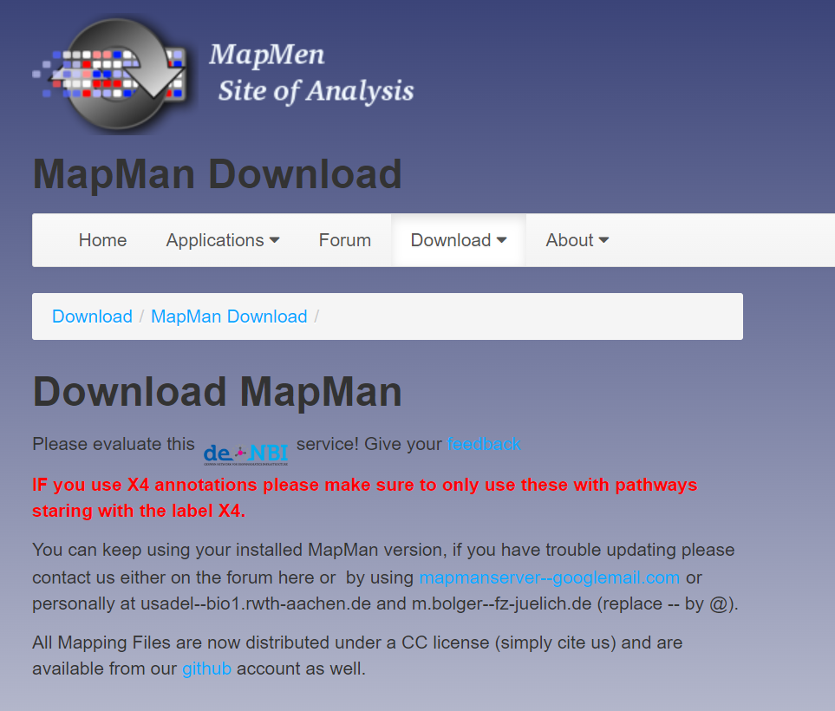
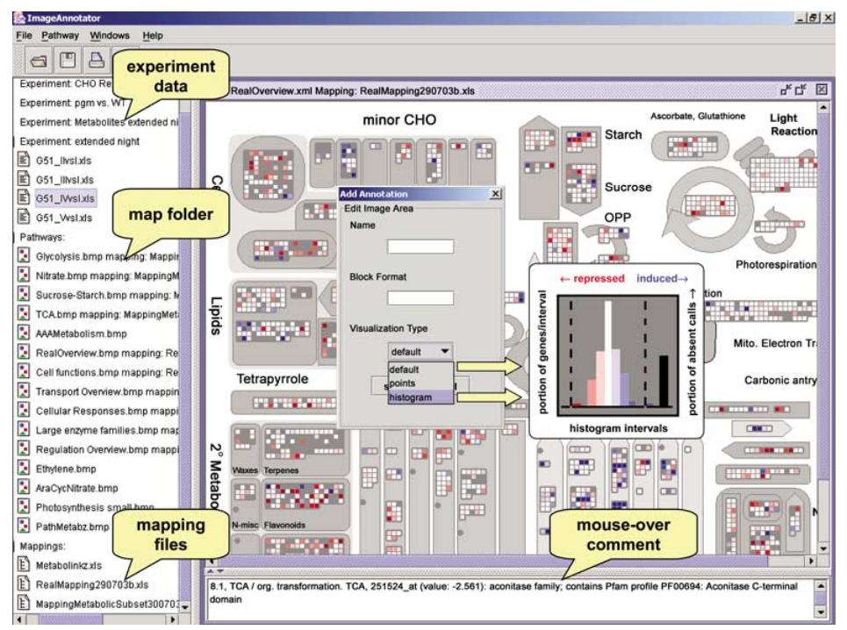
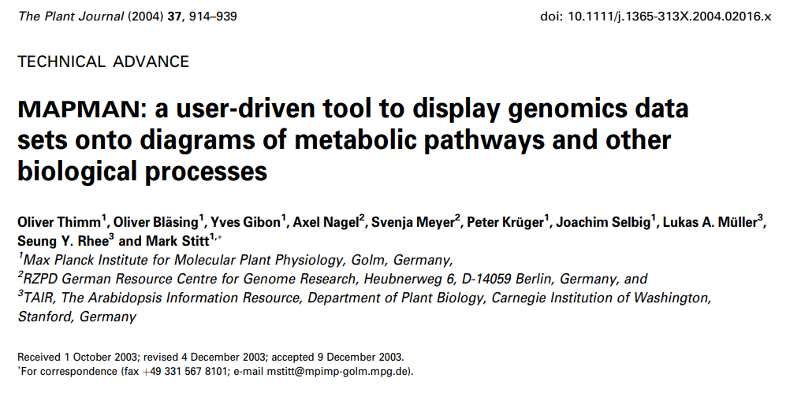

MapMan: nice annotations for plants
https://www.plabipd.de/mercator_main.html

Slide 14
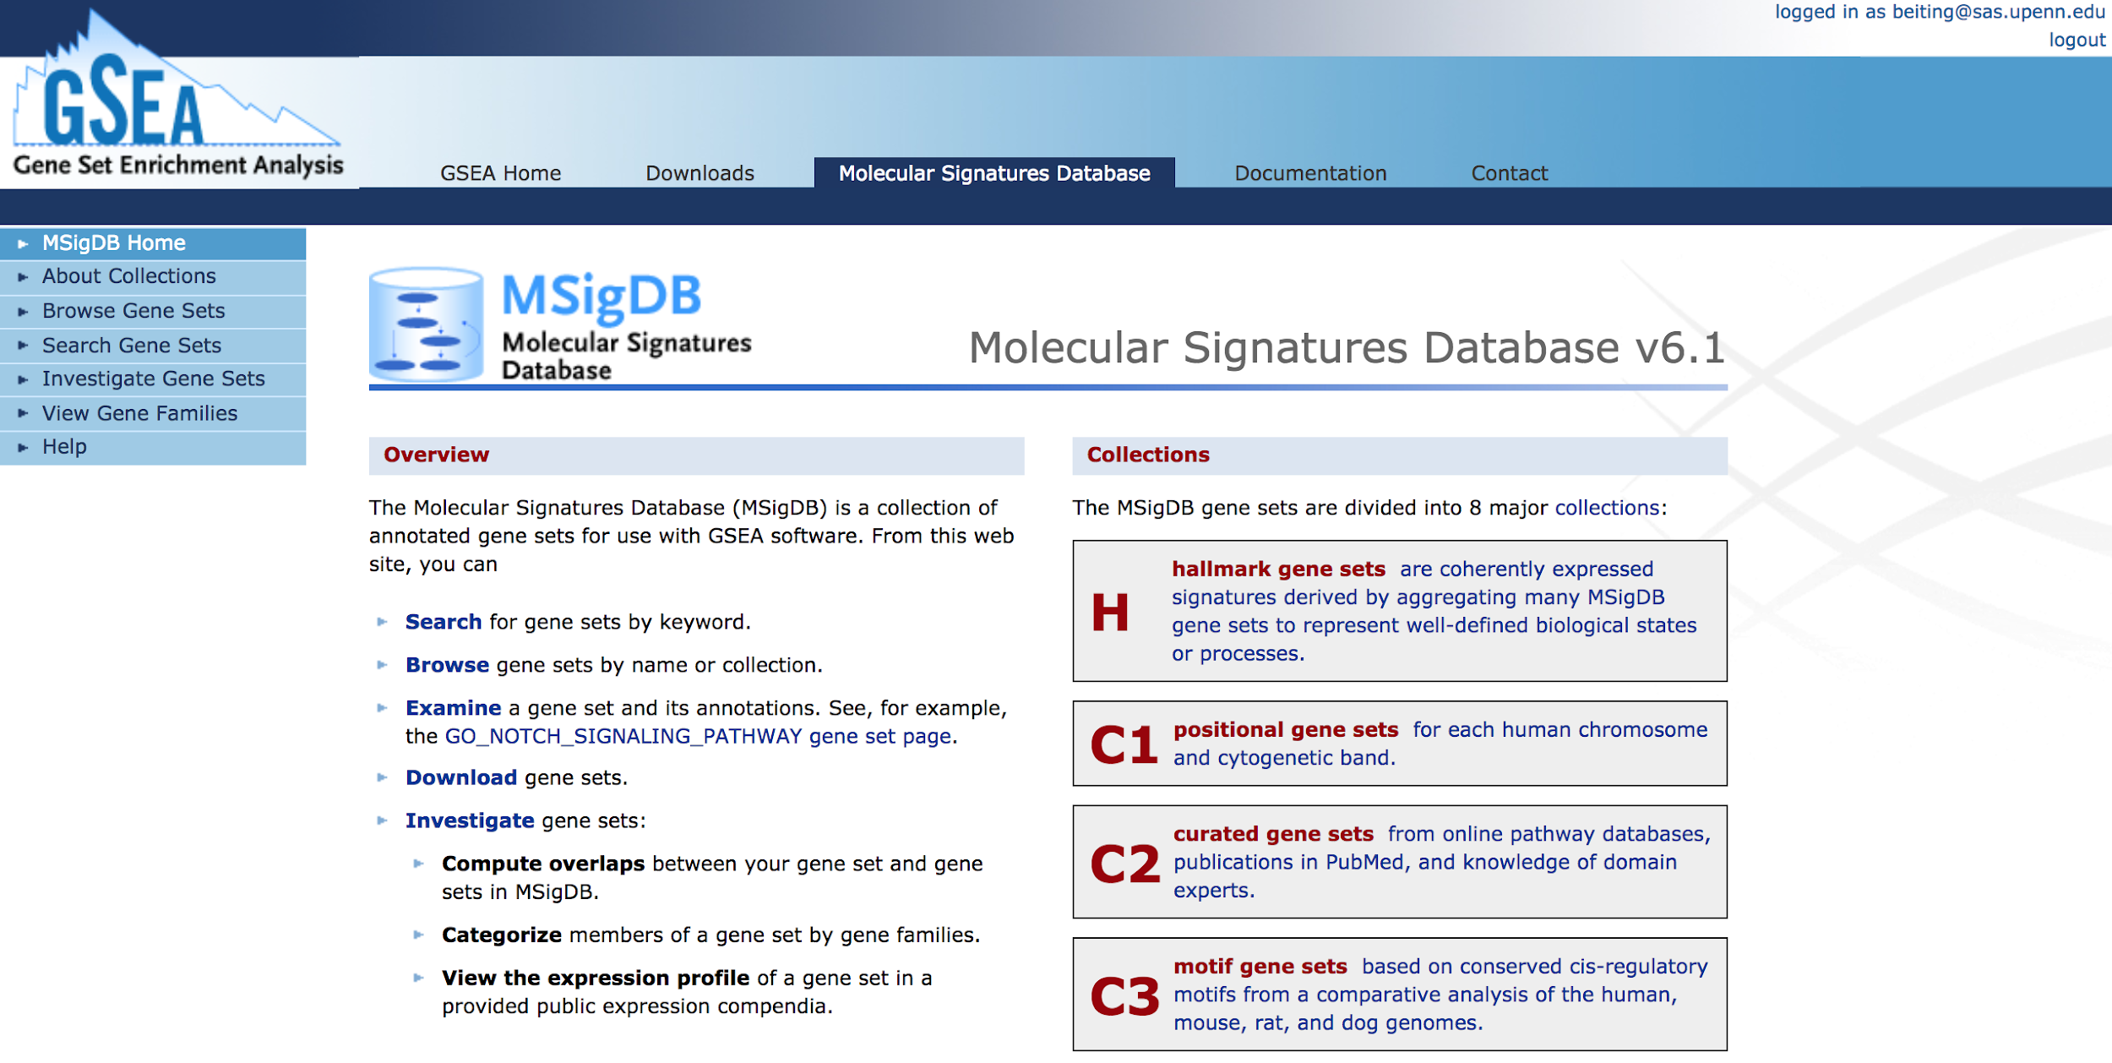
MSigDB: a curated signatures database
The Molecular Signatures Database (MSigDB)

Slide 15
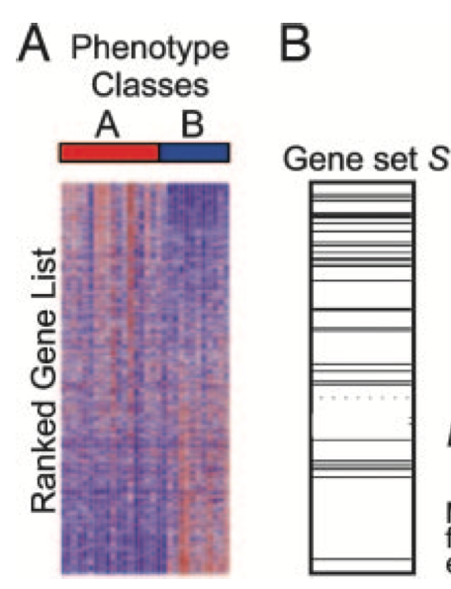
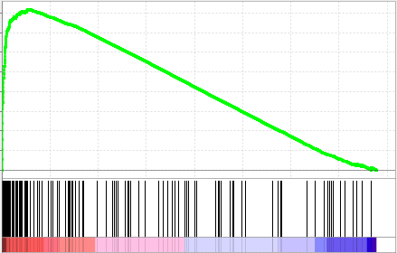
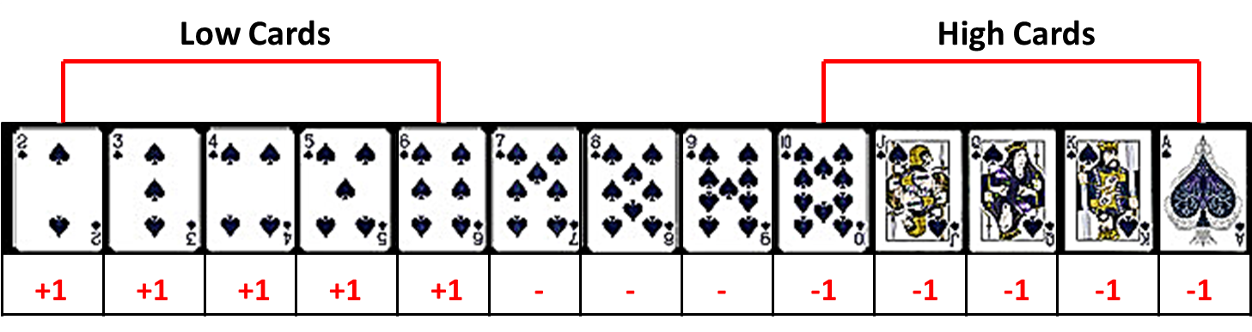
GSEA is a bit like counting cards
enrichment
score (ES)
‘high’ genes, + score
running sum
‘low’ genes, - score
treated
control

Slide 16

Gene Set Enrichment Analysis (GSEA)
two main flavors
Most popular
Self-contained
Competitive
Are genes in my set more commonly differentially expressed than genes outside the set?
Are any of the genes in my set differentially expressed?
Does not consider genes outside your set
Does consider genes outside your set

Slide 17
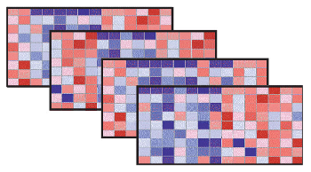
How is significance determined for GSEA?
Permutation is frequently used to determine if an enrichment score is statistically significant
Permuting samples is preferred, but large n required (≥ 7 per group).
Permuting genes is a common alternative, but is subject to inter-gene correlations which can inflate type I error^{1,2}.
¹Gatti et al. BMC Genomics, 2010
²Wu and Smyth, NAR, 2012

Slide 18
Start Step 5 script!

